Slide 1
Solar radiation modification (SRM): technology and risks review
Cormac Dineen
SSRG meeting March 2026

Slide 2
Context

Slide 3
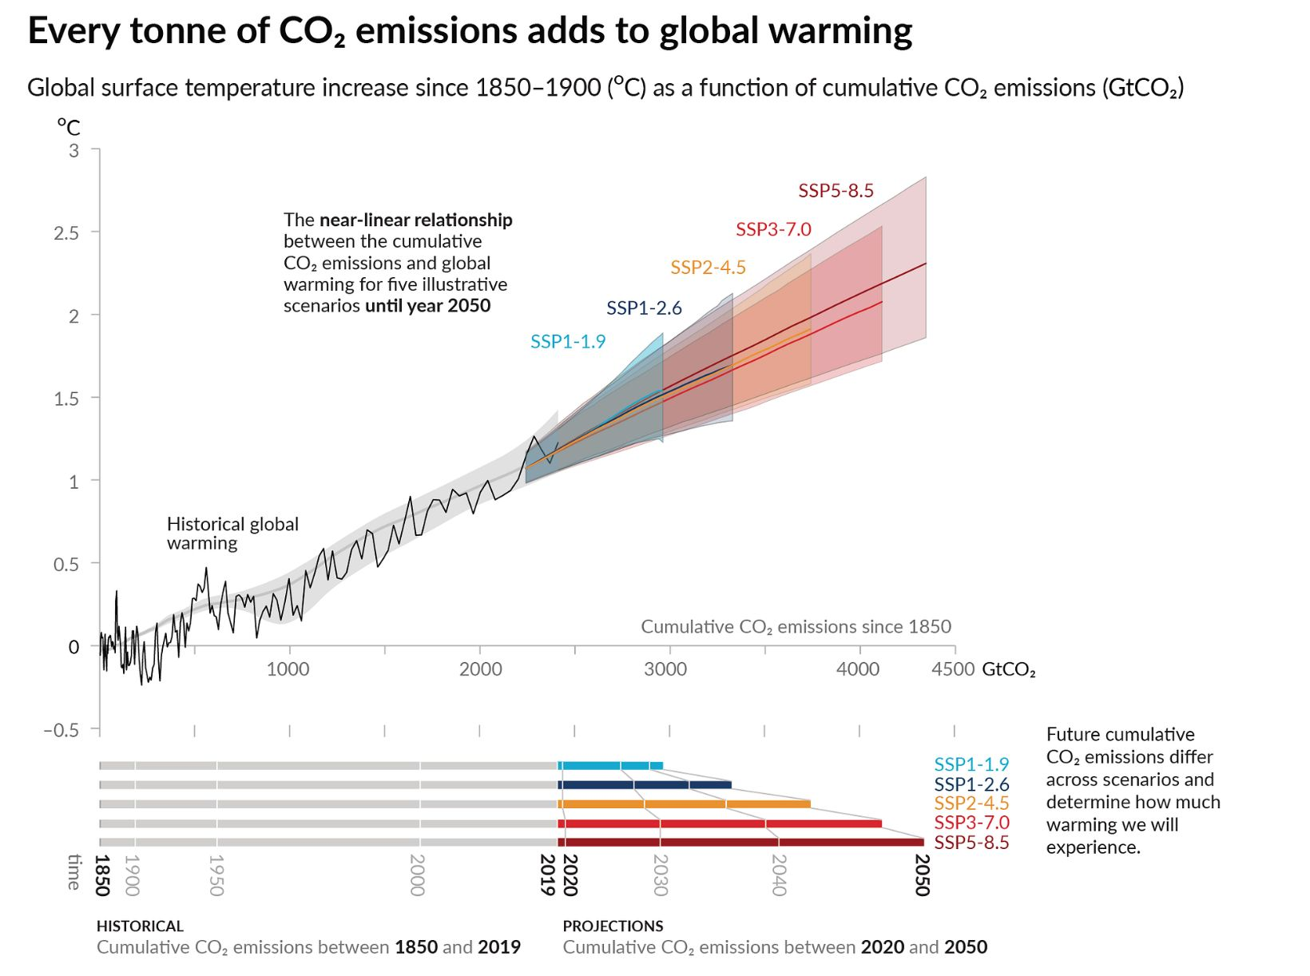
Impact of cumulative emissions
Transient Climate Response to cumulative Emissions (TCRE)
Global surface temperature increases near linearly with cumulative CO2 emissions. Every 1000 GtCO2 adds ≈ 0.45°C of warming.
The bathtub
If we turn off the taps (emissions), the water level (concentrations) stops rising immediately, however the water level remains high (temperatures), and can still splash about and cause damage (impacts).
REF: IPCC AR6 Figure SPM.10
Notes:
We've added bout 2390 GT

Slide 4
The causal chain of climate change
1
3
5
Economy
Concentrations
Impacts
1
2
3
4
5
2
4
Emissions
Temperatures

Slide 5
Key Climate Change Response Strategies
1. Decarbonisation
2. Carbon removal
Energy (renewables, nuclear) and non energy related emissions generating activities (cement, agriculture) can break the link between the economy and future GHG emissions
Technology (afforestation, enhanced weathering, ocean alkalinity, BECCS, DACS) can break the link between cumulative GHG emissions, and climate change
3. Solar radiation modification
4. Adaptation
in particular, sunlight reflection (stratospheric aerosols, marine cloud brightening) can break the link between atmospheric GHG concentrations and temperatures
Building infrastructure (sea walls, coastal defences, nature restoration, resilient infrastructure) can weaken the link between temperatures and impacts on human society and ecosystems
REF: Compton Lecture Series: Climate as a 4D Problem (David Keith)

Slide 6



Opportunities and risks for each response strategy
Strategy | Opportunities | Risks | Technological readiness
1. Decarbonisation | ✓ Avoid worst impacts ✓ Economic innovation & jobs ✓ Health benefits | Transition disruption & stranded assets Political, economic and social impacts Fairness for developing countries
2. Carbon removal | ✓ Removes historical/residual emissions ✓ Potential ecosystem co-benefits | Moral hazard (license to continue burning fossil fuels) Permanence & land-use conflicts
3. Solar radiation modification | ✓ Rapid cooling potential in crisis ✓ Avoidance of tipping points | High uncertainty Governance risks & moral hazard Risk on rainfall patterns
4. Adaptation | ✓ Protects communities & assets ✓ Avoided damages > investment | Finance & capacity gaps Limits in extreme warming

Slide 7
Solar Radiation Modification (SRM)

Slide 8

Natural phenomenon
Mount Pinatubo (1991)
The eruption of Mount Pinatubo (1991) in the Philippines was a catastrophic disaster and over 847 people lost their lives. Beyond the immediate devastation, the eruption had measurable global climate impacts.
Injection
The volcano blasted ≈ 20 million tons of sulfur dioxide straight into the Stratosphere (≈ 35 km).
Dispersal
The SO2 converted into a mist of sulfuric acid droplets (aerosols). This haze spread around the equator and then the globe.
Result
This aerosol layer reflected roughly 2.5% of incoming sunlight, causing average global temperatures to drop by 0.5°C (0.9°F) for about 15 months, almost identical to Krakatoa (in 1883).
REF: U.S. Geological Survey (via Wikipedia)

Slide 9

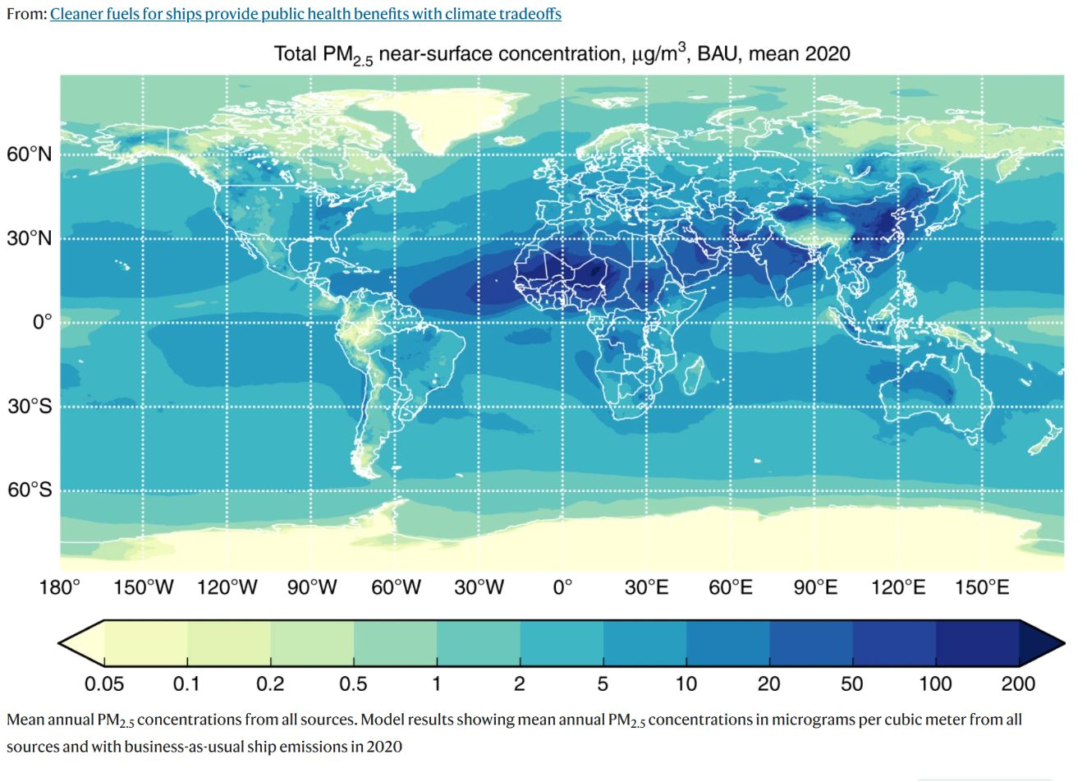
Human phenomenon
Shipping sulphates
The International Maritime Organisation (IMO) introduced limits to sulphur in fuels to protect against acid rain and related respiratory diseases. Sofiev et al. estimated ~400,000 premature deaths annually due to shipping fuels
Before 2020
Ships burned high-sulphur fuel (up to 3.5% S). This emitted ~8 million tonnes of SO2 per year into the lower troposphere, producing reflective aerosols that had a measurable cooling effect, an unintended, unmanaged form of solar radiation modification.
After 2020
The IMO's 2020 regulation reduced sulphur limits to 0.5%, sharply cutting those emissions. Yuan et al. 2024 observed anomalous North Atlantic sea surface temperature increases shortly after, suggesting the regulation may have contributed.
Note: Extent of causal attribution to IMO 2020 is debated, 2023 North Atlantic temperatures also reflect El Nino and long-term warming.
REF: Sofiev et al "Cleaner fuels for ships provide public health benefits with climate tradeoffs"

Slide 10
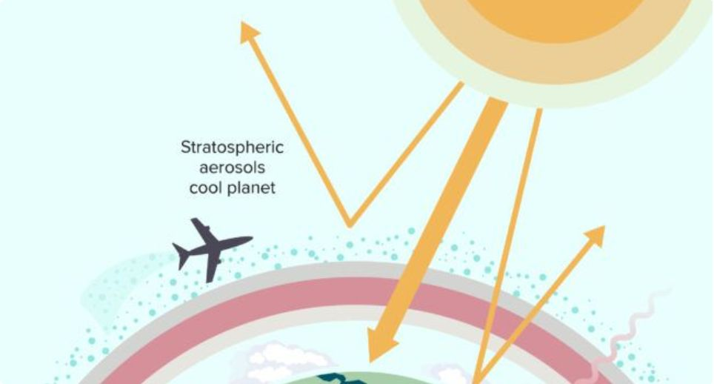
SRM technology
Stratospheric Aerosol Injection (SAI)
Mechanism
Aircraft inject SO2 or CaCO3 into the stratosphere (~20-25km). Oxidises to reflective sulphate aerosols, mimicking a volcanic eruption.
Scale and effect
Global. Stratospheric aerosols are swept around the world by atmospheric currents. Aerosols persist 1-2 years.
Reversibility
Requires continuous replenishment. Stopping abruptly causes rapid temperature rebound ("termination shock"), the defining risk.
REF: Columbia Climate School
Governance challenge
Intrinsically global, unilateral deployment by one nation alters all others' weather patterns. No international framework exists.

Slide 11
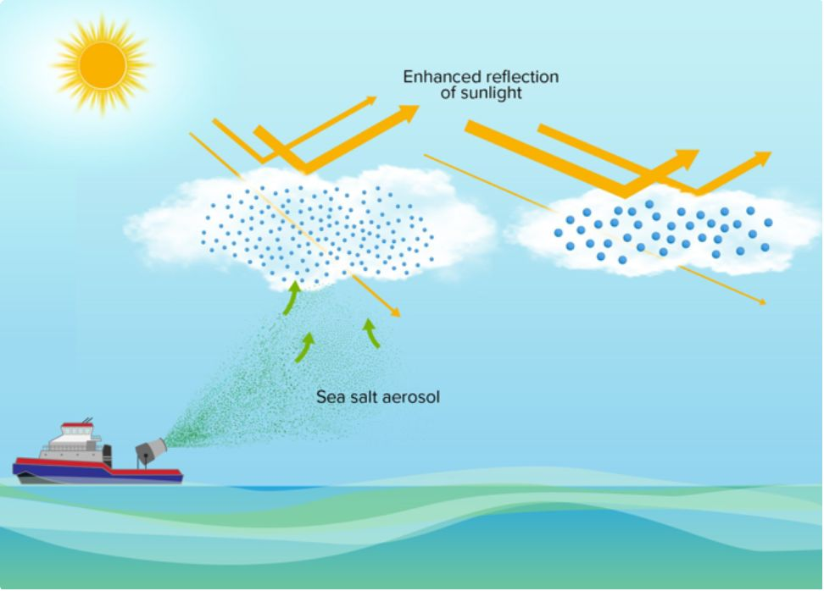
SRM technology
Marine Cloud Brightening (MCB)
Mechanism
Ships spray fine sea-salt aerosols into low marine clouds, increasing droplet density (Twomey effect), making clouds whiter and more reflective.
Scale and effect
Regional to hemispheric. High uncertainty about downstream effects on regional precipitation patterns.
Reversibility
Highly reversible, effects dissipate within days of stopping. No termination shock equivalent. Expected lower risk profile than SAI.
REF: Feingold et al "Physical science research needed to evaluate the viability and risks of marine cloud brightening"
Governance challenge
A single coastal nation could deploy unilaterally. Regional effects still cross borders, but governance is more tractable than for global SAI.

Slide 12

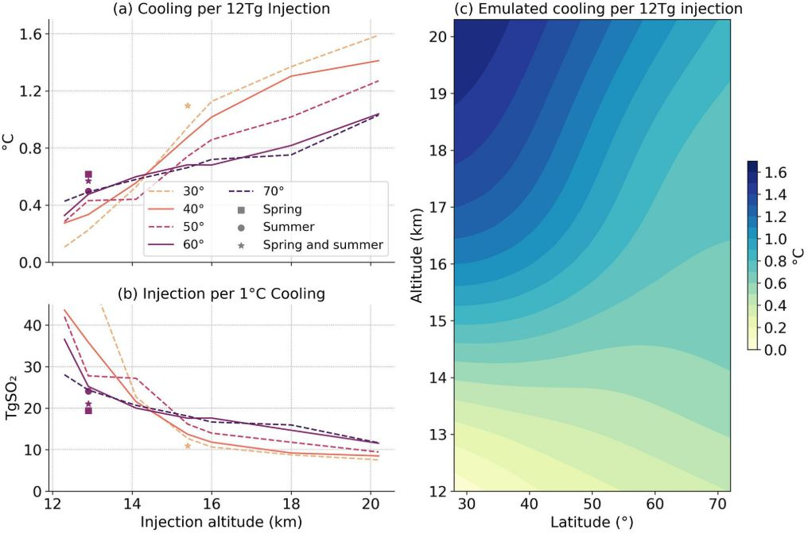
The predicted cooling effect
Consensus across climate models predict that ~1–2°C of global mean cooling is achievable with continuous injection (REF: Geoengineering Model Intercomparison Project)
Targeted cooling
Climate models consistently predict that SAI could be used to maintain global mean temperatures at specific targets, such as 1.5°C or 1.0°C above pre-industrial levels
Efficacy
Continuous injection of approximately 5 Tg S (roughly 10 Tg SO2) per year is projected to offset roughly half of the warming expected under high-emission scenarios.
How do we know?
Multiple independent climate models (from the US, UK, and Europe) converge on this ~1–2°C figure using the same 5 Tg S input. These models have a 50-year track record of predicting global mean warming in response to CO2 concentration increases with reasonable accuracy, although performance on atmospheric CO2 may not correlate to performance on stratospheric SO2.
REF: Duffey et al. "Low‐Altitude High‐Latitude Stratospheric Aerosol Injection Is Feasible With Existing Aircraft"

Slide 13




Risks
Termination shock
SAI deployed
SAI stops abruptly
Rapid rebound
Temperatures stabilise or fall. CO2 continues rising in background.
Aerosol veil settles out within 1-2 years. Full CO2 forcing suddenly unmasked.
Temperatures rise at 2-4x background rate very rapidly. Ecosystems and societies have no time to adapt.
The lock-in problem
Once solar geoengineering is started at a scale sufficient to produce meaningful cooling, stopping becomes extremely dangerous, unless atmospheric CO2 has sufficiently also been reduced in parallel. This means SAI deployment likely creates a multi-generational commitment. Any geopolitical instability, war, or funding collapse that interrupts the programme could cause sudden, catastrophic warming.
REF: Jones et al. (2013), Nature Climate Change; Parker & Irvine (2018), ERL

Slide 14
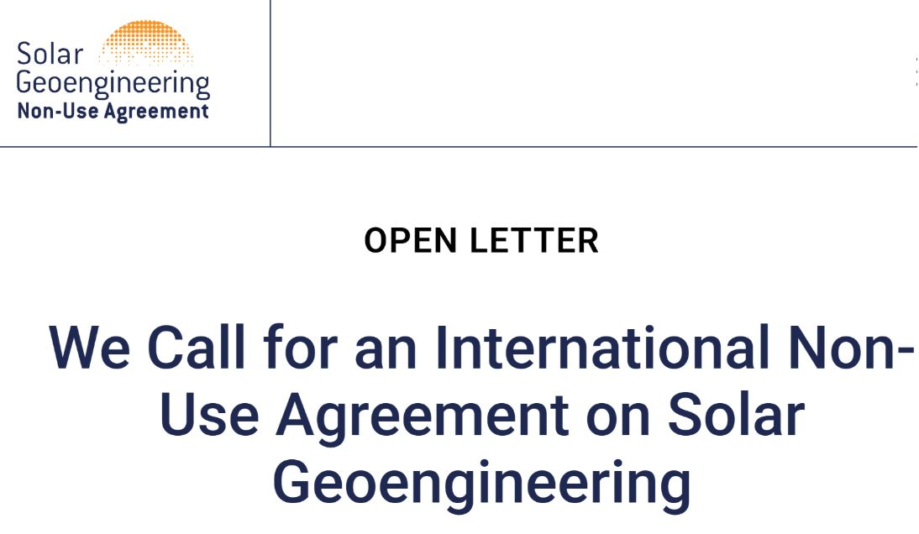
Risks
Governance and deployment
There is currently no international governance framework for solar geoengineering. A UN Environment Assembly resolution on solar geoengineering governance failed to pass in 2024. The absence of rules does not prevent deployment.
Rogue state scenario
A nation facing existential climate risk, like low-lying islands, sub-Saharan drought zones, could plausibly decide to deploy solar geoengineering unilaterally. The technology is estimated to cost as little as $10 billion/year at scale, and technologically accessible to mid-size economies, though sustaining it against opposition from a major power is another matter (Horton et al., 2025). There is no treaty that prohibits it.
Regional winners and losers
Solar radiation modification cooling effects are not geographically uniform. Climate models consistently show differential impacts on regional precipitation, particularly the Asian and African monsoons. A deployment optimised for one region's climate could impair another's food security by altering rain patterns. There is no reason to expect winners and losers to agree to deployment.
Governance of research and deployment
Even governing outdoor experiments is contested. The SCoPEx stratospheric balloon experiment (Harvard, Kiruna, Sweden) was halted in 2021 after opposition from community groups, and abandoned in 2024. There is a large group of academics who have come out against any funding, research, experiments or deployment for the technology.
REF: https://www.solargeoeng.org/non-use-agreement/open-letter/

Slide 15
Normalising costs against carbon removal cost
To compare the feasibility of the potential response strategies, we can do a back of the envelope estimate of cost per ≈ 0.1C of warming. SAI is estimated to be 100x – 1000x cheaper than removal technologies.
Technological removal cost (USD per tCO₂ removed) | Implied global cost to avoid ~0.1°C warming
$50 | ≈ $11 trillion
$100 | ≈ $22 trillion
$200 | ≈ $44 trillion
$1000 | ≈ $220 trillion
The IPCC (AR6 WG1) state that global mean surface temperature is approximately linearly proportional to cumulative CO₂ emissions. They express this proportionality using the Transient Climate Response to cumulative Emissions (TCRE), which they give as 0.45C per 1000 GtCO2 (or 220 GTCO2e per 0.1C)
Global GDP, 2025 : $110 trillion
Limitations: These are MASSIVELY UNCERTAIN, global scale, order of magnitude estimates. They assume all CO2 removal occurs at the same cost; real world scenarios will deploy a mixture of carbon removal technologies, and learning curves may bring cost down.

